Slide 1
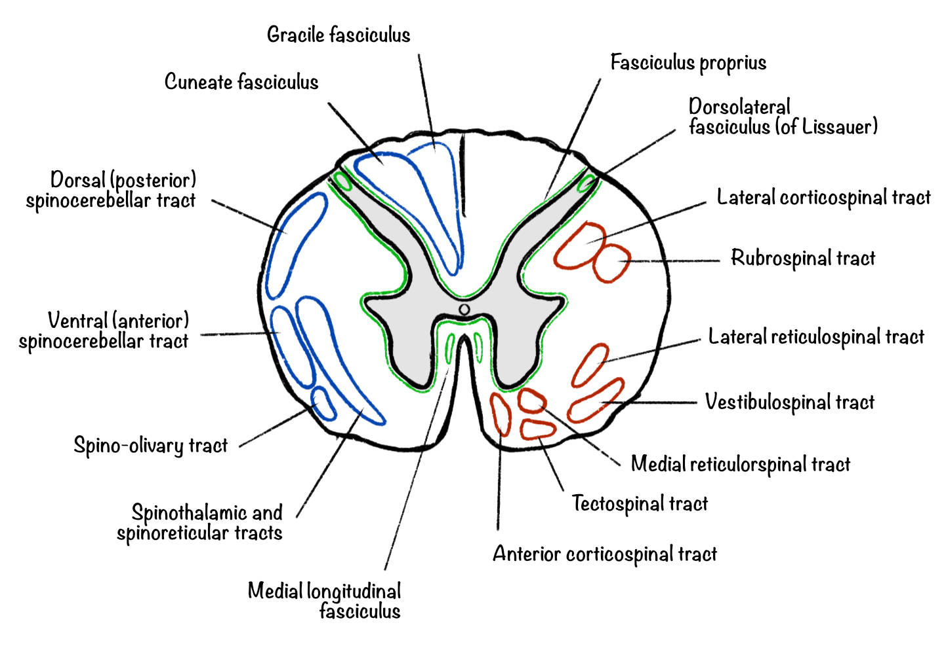
TRACTS OF SPINAL CORD
Prepared by
Dr. MINI S.K BHMS, MD (Hom)
Professor & HOD ,
Dept. of PHYSIOLOGY and BIOCHEMISTRY)

Slide 2
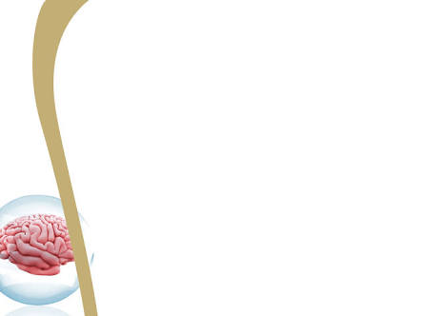
INTRODUCTION
Spinal cord is a long, thin, tubular bundle of nervous tissue and support cells that extends from the medulla oblongata in the brainstem to the lumbar region of vertebral column. The spinal cord extends upto between first and second lumbar vertebra where it ends. It is about 45cm in males and 43cm in females.
The lower end is conical and called the conus medullaris.The apex of conus is continued down as filum terminalis.Along its length, the cord presents two thickenings, the cervical and lumbar enlargements, which give rise to large nerves for the limbs.
The spinal cord give 31pairs of spinal nerves. As the spinal cord is shorter than the length of the vertebral column, the spinal segments do not lie opposite the corresponding vertebrae.

Slide 3
INTERNAL STRUCTURE
When seen in transverse section the grey matter of spinal cord forms an ‘H’shaped mass. In each half of the spinal cord, the grey matter is divisible into
Anterior grey column(or horn)
Posterior grey column(or horn)
In all thoracic and first two lumbar segments of spinal cord, a small lateral grey horn is also present. The grey matter of the right and left halves of the spinal cord is connected across the midline by the grey commissure which is traversed by the central canal.

Slide 4
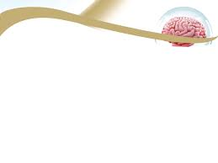
The white matter of spinal cord is divisible into right and left halves, in front by a deep anterior median fissure and behind by the posterior median septum. In each half ,the white matter is divided into
Posterior white column or posterior funiculus
Lateral white column or lateral funiculus
Anterior white column or anterior funiculus

Slide 5
The white matter of the right and left sides is continuous across the midline through white commissure which lies anterior to the grey commissure.
The spinal cord gives attachment on either side, to the series of spinal nerves. Each spinal nerve arises by two roots
Anterior
Posterior
Each root is made up of number of rootlets. The length of the spinal cord gives origin to the rootlets for one pair of spinal nerves constitutes one spinal segment.

Slide 6
NUCLEI OF SPINALCORD
Grey matter of spinal cord is arranged in three horns.
Anterior is motor.
Lateral is visceral afferent and afferent in function.
Posterior is sensory in function.
Nuclei in anterior grey column or horn are medial group, lateral group and central group. They innervate the skeletal muscles.
Nuclei in lateral horn are intermediolateral nucleus, intermediomedial nucleus.
Nuclei in posterior grey column are posteromarginal nucleus, substantia gelatinosa, nucleus proprius, and nucleus dorsalis.

Slide 7
TRACTS OF SPINAL CORD
Group of nerve fibres passing through the spinal cord are known as tract of spinal cord.
Tracts are named after the names of masses of grey matter connected by them. Name consists of two components-first term is origin. second term is termination.

Slide 8
CLASSIFICATION OF TRACTS
Tracts are classified into
Ascending tract
Descending tract

Slide 9
ASCENDING TRACT
Lateral spinothalamic tract
Anterior spinothalamic tract
Fasciculus cuneatus
Fasciculus gracilis
Dorsal or posterior spinocerebellar tract
Ventral or anterior spinocerebellar tract
Spino-olivary tract
Spinotectal tract

Slide 10
DESCENDING TRACT
Pyramidal or corticospinal tract descends from cerebral cortex to spinal cord. It has two parts
The lateral corticospinal tract, which lies in lateral funiculus.
The anterior corticospinal tract, which lies in anterior funiculus.
Extra pyramidal tract
Rubrospinal tract
medial and lateral reticulospinal tract
Olivospinal tract
Vsetibulospinal tract
Tectospinal tract

Slide 11
ANTERIOR SPINOTHALAMIC TRACT
Anterior spinothalamic tract is formed by the fibres of second order neurons of the pathway for crude touch sensation. Anterior spinothalamic tract is situated in the anterior funiculus near the periphery.
ORIGIN
Fibres of anterior spinothalamic tract arise from the neurons of chief sensory nucleus of posterior grey horn,which form the second order neurons of the crude touch pathway.
The first order neurons are situated in the posterior nerve root ganglia.these neurons receive the impulses of crude touch sensation from the pressure receptors.
Axons of first order neuron reach the chief sensory nucleus through posterior nerve root.

Slide 12
ANTERIOR SPINOTHALAMIC TRACT

Slide 13
COURSE
The axons of second order neuron cross obliquely in the anterior white commissure and thus ascend in the anterior or antrolateral column of opposite side as anterior spinothalamic tract.
TERMINATION
At the upper border of pons and midbrain, this tract along with the and internal arcuate fibres runs in the medial lemniscus and terminate in the ventro posterolateral nucleus of thalamus.
From here the third order neuron’s axon carry impulses to somesthetic area of cerebral cortex.

Slide 14
FUNCTION
This tract is for fine touch and tactile localisation.
EFFECT OF LESION
Bilateral lesion of the tract leads to loss of crude touch sensation and loss of sensation like itching and tickling.
Unilateral lesion of this tract leads to loss of crude touch sensation in opposite side below the level of lesion.

Slide 15
LATERAL SPINOTHALAMIC TRACT
Lateral spinothalamic tract is formed by the fibres from second order neurons of the pathway for the sensations of pain and temperature.
SITUATION
Lateral spinothalamic tract occupies the lateral column of the white matter in the spinal cord.
ORIGIN
Fibres take origin from substantia gelatinosa of Rolando.

Slide 16
COURSE
The axons of second order neuron cross in the anterior white commissure obliquely to the opposite side of the same segment and ascend in the lateral column of the spinal cord.
Fibres of the second order neuron before crossing,may ascend up one segment and cross in the anterior white commissure to reach the lateral column of the opposite of the cord.
This tract together with ventral spinothalamic tract constitutes the spinal lemniscus in the medulla oblongata.
The spinal lemniscus then ascends up to join the medial lemniscus in the upper part of the medulla oblongata and finally terminate in the ventral posterolateral nucleus of the thalamus.

Slide 17
LATERAL SPINOTHALAMIC TRACT

Slide 18
TERMINATION
In thalamus, the third order neuron starts and axons of this neuron terminate in the posterolateral gyrus of the cerebral cortex.
FUNCTION
The lateral spinothalamic tract carries
Fibres of all pain impulses.
All temperature impulses both heat and cold.
EFFECT OF LESION
Bilateral lesion of this tract leads to total loss of pain and temperature sensation on both sides below the level of lesion.
Unilateral lesion causes loss of pain and temperature below the level of lesion on the opposite side.

Slide 19
FASCICULUS GRACILIS(TRACT OF GOLL)
Fasciculus gracilis and fasciculus cuneatus are together called ascending posterior column tracts.
SITUATION
Tract of goll and burdach are situated in posterior white column of spinal cord. Fasciculus gror root ganglia receiving afferents from lower half of the body.

Slide 20
COURSE
• After entering the spinal cord, the Fibers ascend through the posterior white column. These fibres do not synapse in the spinal cord.
• Some fibres of medial division of posterior nerve root descend through posterior white column in the form of fasciculus interfascicularis or common tract of schultze.
• The axons of this fibres end in the medulla in the nucleus gracilis. Here the first relay takes place and second order neuron arises.

Slide 21
TRACT OF GOLL AND BURDACH

Slide 22
TERMINATION
• The axons of second order neuron are divided into two groups: external and internal arcuate fibres. The internal arcuate fibres being the axons of the second order neuron, cross to the opposite side, enter the medial fillet or lemniscus, pass through midbrain and end in ventral posterolateral nucleus of thalamus. Here the second relay takes place and third order neuron arises.
• From here, fibers of the third order neuron relay to sensory area of cerebral cortex.

Slide 23
FUNCTIONS
• Fine touch sensation, tactile localisation and tactile discrimination.
• Kinaesthetic sensation
• Sense of vibration
• Some unconscious impulses passing through the cerebellum through external arcuatefibres.
• May constitute the sensory pathway for some superficial reflexes.

Slide 24
FASCICULUS CUNEATUS (TRACT OF BURDACH)
The course relay termination and functions are same as that of tract of goll. The differences are
It is made up of posterior root fibres from upper half of the body.
Situated laterally in the posterior column of the upper thoracic and cervical regions only.
Ends in medulla in nucleus cuneatus.

Slide 25
VENTRAL SPINOCEREBELLAR TRACT (GOWER’S TRACT)
It is constituted by the fibers of second order neurons of the pathway for subconscious kinaesthetic sensation.
SITUATION
It is situated in the lateral white column of the spinal cord along the lateral periphery.

Slide 26
ORIGIN
Fibres of this tract arise from the marginal nucleus in posterior grey horn. Neurons of marginal nucleus form the second order neurons. Fibers from these neurons make their first appearance in lower lumbar segments of spinal cord.
First order neurons are in the posterior root ganglia and receive the impulses of proprioception from the proprioceptors in muscle, tendon and joints. Fibers from neurons of posterior root ganglia reach the marginal cells through posterior nerve root.

Slide 27
FLECHSIG'S AND GOWER'S TRACT

Slide 28
COURSE
• Ventral spinocerebellar tract contains both crossed and uncrossed fibers.Mojority of the fibers from the marginal nucleus cross the midline and ascend in the lateral white column of the opposite side.
• Some fibres ascend in the lateral white column of same side also.
• These fibres ascend through other spinal segments medulla, pons and midbrain.
• Finally the fibers reach cerebellum through the superior cerebral peduncle.

Slide 29
TERMINATION
These fibres terminate in the cortex of the anterior lobe of cerebellum.
FUNCTION
Carries impulses of subconscious kinaesthetic sensation are also called non-sensory impulses.
EFFECT OF LESION
Lesion of this tract leads to loss of subconscious kinaesthetic sensation in the opposite side.

Slide 30
DORSAL SPINOCEREBELLAR TRACT (FLECHSIG’S TRACT)
SITUATION
It is situated in the lateral column along the posterolateral part of spinal cord.
ORIGIN
Fibers of this tract originate from dorsal nucleus of Clark.
COURSE
• This tract is formed by uncrossed fibers.
• Axons from neurons in dorsal nucleus of Clark reach lateral column of same side.
•Then these fibres ascend through other spinal segments and reach medulla oblongata.
• From here, the fibers reach cerebellum through inferior cerebellar peduncle.

Slide 31
TERMINATION
These fibres terminate in the cortex of the anterior lobe of cerebellum.
FUNCTION
Carries impulses of subconscious kinaesthetic sensation are also called non-sensory impulses.
EFFECT OF LESION
Lesion of this tract leads to loss of subconscious kinaesthetic sensation in the opposite side.

Slide 32
SPINOTECTAL TRACT
SITUATION
It is situated in lateral column ventral to lateral spinothalamic tract.
ORIGIN
Fibers originate from chief sensory nucleus.
COURSE
The fibres cross to opposite side through anterior white commissure to the lateral column.
Then these fibers ascend to the midbrain along with lateral spinothalamic tract.

Slide 33
SPINOTECTAL TRACT

Slide 34
TERMINATION
Fibres of this tract terminate in superior colliculus of tetum in midbrain.
FUNCTION
Concerned with spinovisual reflex.

Slide 35
SPINO OLIVARY TRACT
This tract is originated from the cells of the dorsal horn of grey matter of all levels of spinal cord. These fibres terminate in the olivary nucleus of medulla oblongata. From here the neurons project into cerebellum.
FUNCTION
It is concerned with proprioception.

Slide 36
SPINOVESTIBULAR TRACT
Spinovestibular tract is situated in the lateral white column of spinal cord. Fibers of this tract arise from all segments of spinal cord and terminate in the lateral vestibular nucleus. This tract is also concerned with proprioception.

Slide 37
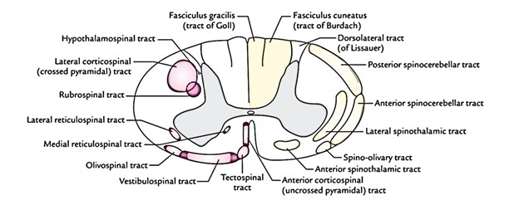
DESCENDING
TRACT

Slide 38
PYRAMIDAL TRACT
This is the longest tract starting from the motor cortex and reaching upto the last segment of the spinal cord. These are otherwise known as corticospinal tracts-anterior and lateral corticospinal tract. They give the appearance of a pyramid on the upper part of anterior surface of medulla. Hence the name pyramidal tract.
ORIGIN
Fibres arise from
Giant cells or betz cells in precentral gyrus (in area 4) of frontal lobe.
Frontal area and supplementary motor area.
Other parts of frontal lobe.
Sensory areas of parietal lobe.

Slide 39
PYRAMIDAL TRACT

Slide 40
COURSE
CORONA RADIATA
After taking origin, the nerve fibers run downwards in a diffused manner through white matter of cerebral cortex. This fan-like structure is called corona radiata.
INTERNAL CAPSULE
While passing down towards the brainstem the corona radiata converges in the form of internal capsule. It is situated in between thalamus and caudate nucleus on the medial side and lenticular nucleus on the lateral side.

Slide 41
IN PONS
The fibers descend downwards through internal capsule, midbrain and pos. At lower border of pons, the fibers are grouped once again into a compact bundle and then descend down into medulla oblongata.
IN MEDULLA
This compact bundle of corticospinal fibers gives the appearance of a pyramid in the upper part of medulla. So the corticospinal tracts are called pyramidal tract.
At the lower end of medulla, pyramidal tract on each side is divided into two bundles of unequal sizes.
About 80% of the fibres from each side cross the opposite side. While crossing the midline, the fibres of both sides form the pyramidal decussation.

Slide 42
IN SPINAL CORD
Fibres which cross the midline and form pyramidal decussation descend through posterior part of lateral white column of spinal cord.
This bundle of crossed fibers is called crossed pyramidal tract or lateral corticospinal tract.
Remaining 20%of fibers do not cross the opposite side but descend down through anterior white column of spinal cord. This is called uncrossed pyramidal tract or corticospinal tract.

Slide 43
TERMINATION
• All fibers of pyramidal tract, both crossed and uncrossed fibres terminate in the motor neurons of anterior grey horn either directly or via internuncial neurons.
• Pyramidal tract fibers terminate on both α-motor neurons and β-motor neurons.
FUNCTION
• Convey motor impulses into the spinal cord for controlling the voluntary movements.
• Also form a part of the pathways for superficial reflexes like cremasteric, abdominal and plantar reflexes.

Slide 44
EFFECT OF LESION
At cerebral cortex
Causes hypertonia, spasticity and contralateral monoplegia or contralateral hemiplegia.
At internal capsule
Lesion of pyramidal tract fibers at posterior limb of internal capsule results in contralateral hemiplegia.
Brainstem
Results in contralateral hemiparesis along with sixth and seventh nerve palsies.
Spinal cord
• Unilateral lesion of the lateral corticospinal fibers at upper cervical segment causes ipselateral paraplegia.
• Bilateral lesion of these fibers in thoracic and lumbar segments results in paraplegia without paralysis of respiratory muscles.

Slide 45
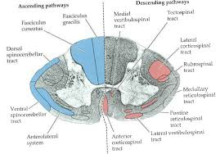
EXTRAPYRAMIDAL TRACT

Slide 46
Descending tracts of spinal cord other than pyramidal tract are called extrapyramidal tract. They are
Medial longitudinal fasciculus
Anterior vestibulospinal tract
Lateral vestibulospinal tract
Reticulospinal tract
Tectospinal tract
Rubrospinal tract
Olivospinal tract

Slide 47
MEDIAL LONGITUDINAL FASCICULUS
SITUATION
Medial longitudinal fasciculus descends through posterior part of anterior white column of spinal cord.
ORIGIN
It is originated from Medial vestibular nuclei, Reticular formation, Superior colliculus, Interstitial nucleus of cajal.

Slide 48
TERMINATION
Anterior motor neurons of the spinal cord.
FUNCTION
Coordination of reflex ocular movements and integration of eye and neck movements.
EFFECT OF LESION
Reflex ocular movements are affected in the lesion of this tract.

Slide 49
ANTERIOR VESTIBULOSPINAL TRACT
SITUATION
It is situated in the anterior white column, lateral to tectospinal tract.
ORIGIN
Medial vestibular nucleus in madulla oblongata.
COURSE
•Fibers run upto thoracic segments pf the spinal cord.
•Fibers of this tract run down from medulla into the anterior column of spinal cord along the periphery.
TERMINATION
Along with fibers of lateral vestibulospinal tract, the fibers of this tract terminate in anterior motor neurons directly or through internuncial nucleus.

Slide 50
ANTRIOR VESTIBULOSPINAL TRACT

Slide 51
LATERAL VESTIBULOSPINAL TRACT
SITUATION
It is present in anterior part of lateral white column of spinal cord.
ORIGIN
Lateral vestibular nucleus (deiter) in medulla.
COURSE
•This tract descends the entire length of spinal cord and ends in the medial part of the anterior horn cells of grey matter.

Slide 52
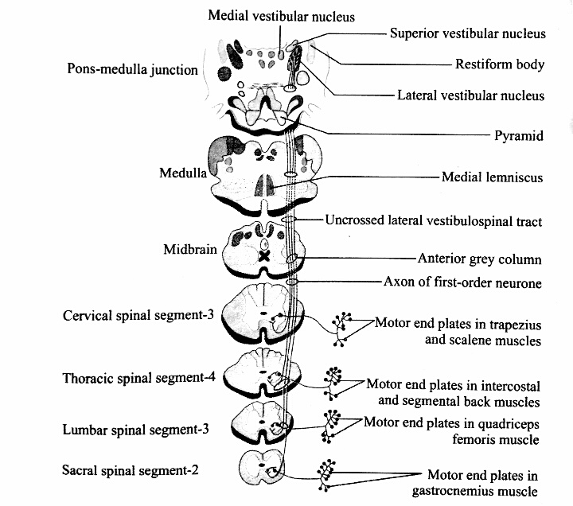
LATERAL VESTIBULOSPINAL TRACT

Slide 53
TERMINATION
It terminate in the anterior motor neuron either directly or via internuncial neurons.
FUNCTIONS
Adjustment of position of head and body during angular and linear acceleration.
EFFECT OF LESION
Adjust of head and body becomes difficult during acceleration when the vestibulospinal tracts are affected by lesion.

Slide 54
RETICULOSPINAL TRACT
SITUATION
It is situated in anterior white column ,posterior to anterior vestibulospinal tract.
ORIGIN
Reticular formation of pons and medulla.
COURSE
• Pontine reticular fibers (uncrossed) descend in medial part of anterior column.
• Fibers of medullary reticular formation (predominantly uncrossed) descend in lateral part of lateral white column and to some extent in anterior part of lateral column.

Slide 55
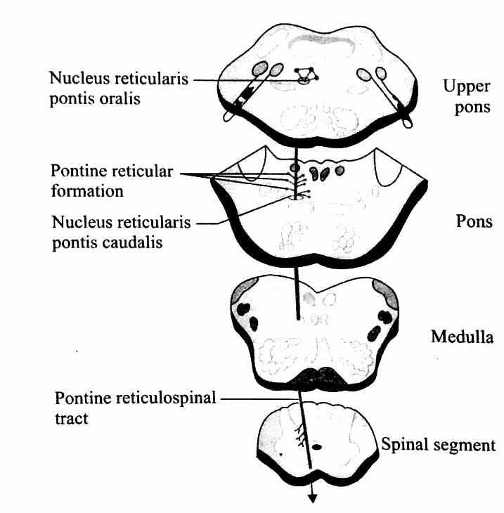
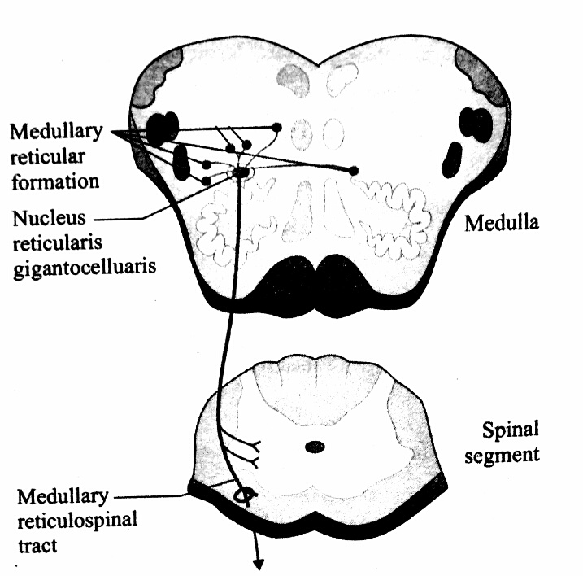
PONTINE AND MEDULLARY RETICULOSPINAL TRACT

Slide 56
TERMINATION
It extends upto thoracic segments and terminate in the gamma motor neurons of spinal cord.
FUNCTION
Stimulation of the brainstem reticular formation can facilitate or inhibit voluntary movement.
• Alter muscle tone.
• Respiration is modified.
• Blood pressure is altered.
• Central transmission of sensory impulses is altered.

Slide 57
TECTOSPINAL TRACT
SITUATION
Tectospinal tract is situated in the anterior white column of spinal cord.
ORIGIN
Nerve fibers of this tract arise from superior colliculus of midbrain.
COURSE
The fibres cross the midline in dorsal tegmental decussation and descend in anterior column up to lower cervical segments.

Slide 58
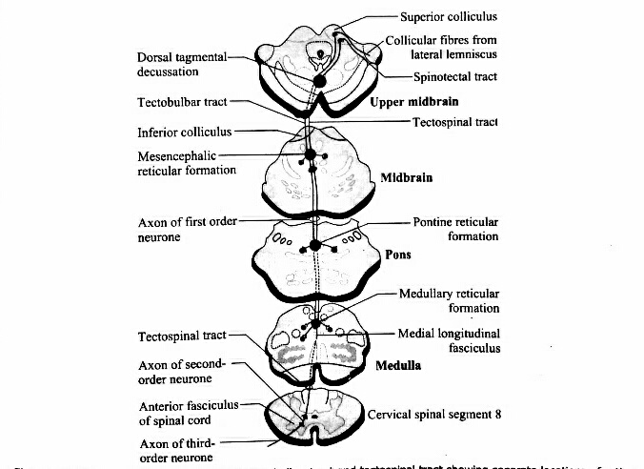
TECTOSPINAL TRACT

Slide 59
TERMINATION
Fibers terminate in anterior motor neurons of spinal cord either directly or through internuncial neurons.
FUNCTION
Movement of head in response to visual and auditory stimuli.

Slide 60
RUBROSPINAL TRACT
SITUATION
Rubrospinal tract is situated in the lateral white column of spinal cord.
ORIGIN
Fibers arise from large cells of red nucleus in midbrain.
COURSE
Fibers cross the midbrain in ventral tegmental decussation and descend into the spinal cord through the reticular formation of pons and medulla.

Slide 61
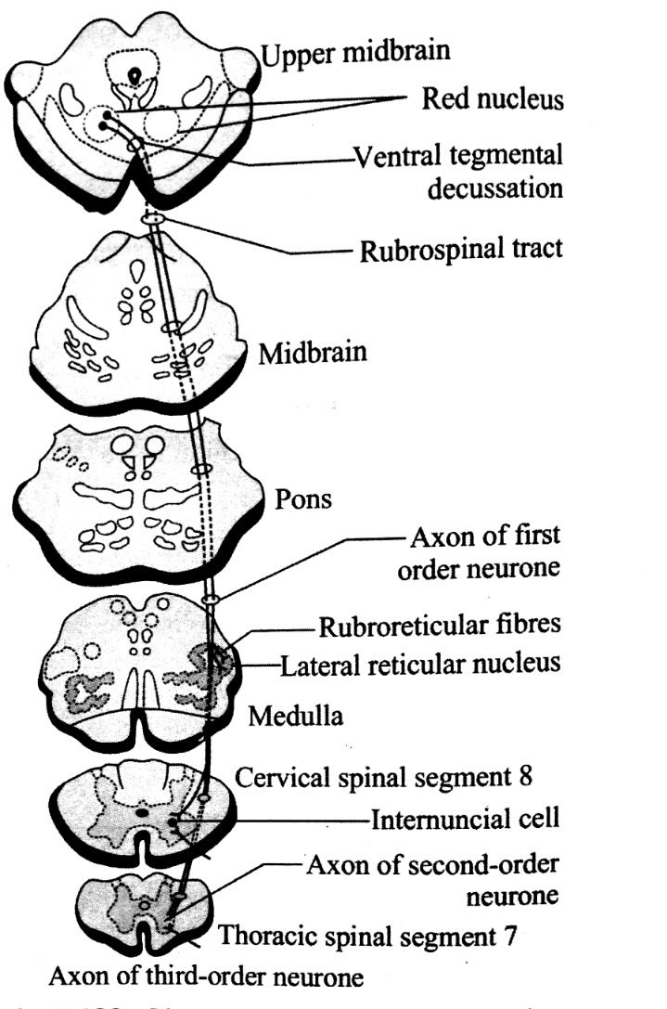
RUBROSPINAL TRACT

Slide 62
TERMINATION
It ends in the anterior motor neurons of spinal cord via internuncial neurons.It extends upto thoracic segments.
FUNCTION
Exhibits facilitatory influence upon flexor muscle tone.

Slide 63
OLIVOSPINAL TRACT
SITUATION
Olivospinal tract is present in the lateral white column of spinal cord.
ORIGIN
Fibers originate from inferior olivary nucleus in medulla oblongata.
TERMINATION
Fibres terminate in the anterior motor neurons of spinal cord.
FUNCTION
It is believed to be involved in reflex movements arising from the proprioceptors.

Slide 64
OLIVOSPINAL TRACT

Slide 65
DISEASES OF SPINAL CORD

Slide 66
1.SYRINGOMYELIA
Syringomyelia is spinal cord disorder characterized by the presence of fluid-filed cavities in the spinalcord. Gray matter around the central canal is the most affected part. So the sensory disturbances are more pronounced than the motor disturbances.
CAUSE
Syringomyelia occurs due to the over growth of neuroglial cells in spinal cord accompanied by cavity formation and accumulation of fluid. Initially, a cavity appears in gray matter near the central canal of spinal cord. In later stages, the cavity extends and involves the surrounding white matter to a variable degree. The disease usually starts in one or two segments. Then, it extends up and down for considerable distances. Lower cervical and upper thoracic regions are affected the most.

Slide 67
FEATURES
Characteristic features of this disease are the loss of pain and temperature sensations and muscular weakness. Severity of the loss of sensations depends upon the extent of disease in spinal cord.
SYMPTOMS
• If disease is only around central canal, there is loss of temperature, pain and crude touch sensations only. It is due to lesion of the fibers crossing through the anterior gray commissure. Fine touch sensation is not affected because the fibers of fine touch pathway are in the posterior white column.
• If lesion is unilateral, effect occurs only on the same side.

Slide 68
• If disease extends to posterior gray horn, all the sensations are lost. Due to loss of pain and temperature sensations, the affected part is not withdrawn either reflexly or consciously from a painful stimulus. So, the affected persons become prone for injuries. Since, the injury is not perceived it leads to severe damage to the tissues.
• If anterior gray horn is affected, there is flaccid paralysis of muscles. In later stages, both pyramidal and extrapyramidal tracts are also involved, if the disease spreads to white matter. It causes spastic paralysis of limbs, especially in lower limbs, resulting in spastic paraplegia. Weakness and wasting of small muscle of limbs occur. Winging of scapula and scoliosis (lateral curvature of spine) develops.

Slide 69
TABES DORSALIS
Tabes dorsalis is another disease of the spinal cord.It is a slowly progressive nervous disorder affecting both the motor and sensory functions of spinal cord.
CAUSES
It occurs due to the degeneration of posterior (sensory) nerve roots. It usually occurs in syphilis. Posterior nerve roots are affected proximal to the posterior root ganglia. Ganglia are not affected. Among the fibers of posterior root, the fibers of lateral division are affected much. Reason for this type of selective degeneration is not known.
FEATURES
Symptoms may not appear for some decades after the initial infection and include weakness, diminished reflexes, unsteady gait, progressive degeneration of the joints, loss of 33 coordination, episodes of intense pain and disturbed sensation, personality changes, dementia, deafness, visual impairment, and impaired response to light.

Slide 70
MULTIPLE SCLEROSIS
MULTIPLE SCLEROSIS
It affects the central nervous system (CNS), but exactly why is happens is unclear.In the CNS, nerve fibers are surrounded by a myelin sheath, which protects them. Myelin also helps the nerves conduct electrical signals quickly and efficiently. In MS, the myelin sheath disappears in multiple areas, leaving a scar, or sclerosis. The areas where there is no myelin or a lack of myelin are called plaques or lesions. As the lesions get worse, nerve fibers can break or become damaged. As a result, the electrical impulses from the brain do not flow smoothly to the target nerve.

Slide 71
SYMPTOMS
• Bladder problems: There may be difficulty emptying the bladder completely, frequent urination, and urge incontinence.
• Bowel problems: Constipation can lead to fecal impaction, and this can lead to bowel incontinence.
• Fatigue: This affects up to 90 percent of patients, and it can undermine their ability to function at work or at home.
• Dizziness and vertigo: These are common problems, along with difficulties with balance. • Sexual dysfunction: A loss of interest in sex is common in both males and females. • Spasticity and muscle spasms: Damaged nerve fibers in the spinal cord and brain can cause painful muscle spasms. Muscles might get stiff and be resistant to movement, known as spasticity.
• Tremor: There may be involuntary quivering movements. • Vision problems: There may be double vision or blurring vision, a partial or total loss of vision, or red-green color distortion. This usually affects one eye at a time. Inflammation of the optic nerve can result in pain when the eye moves.

Slide 72
BROWN-SEQUARD SYNDROME
Brown-sequard syndrome is a rare neurological condition characterised by a lesion in the spinal cord which results in weakness or paralysis(hemiparaplegia) on one side of the body and loss of sensation on opposite side.
CAUSES
Brown-sequard syndrome can be caused due to spinal cord tumor, trauma, ischemia, infectious or inflammatory diseases such as tuberculosis

Slide 73
SYMPTOMS
● Loss of sensation of pain and temperature often below the level of Lesion there may also be loss of bowel and bladder control.
● Weakness and degeneration of muscle.
● Loss of proprioception and vibration sense.

Slide 74
Thank u

